Slide 1
Natural Language Processing Part 1

Slide 2
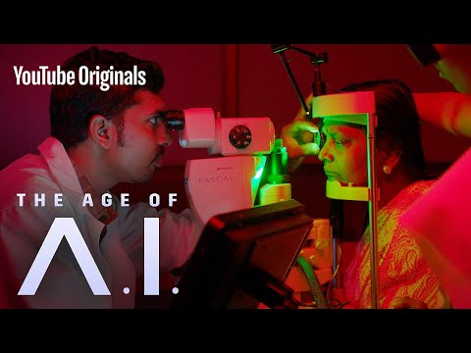

Slide 3
“ What was the Sapiens’ secret of success? How did we manage to settle so rapidly in so many distant and ecologically different habitats? How did we push all other human species into oblivion? Why couldn’t even the strong, brainy, cold-proof Neanderthals survive our onslaught? The debate continues to rage. The most likely answer is the very thing that makes the debate possible: Homo sapiens conquered the world thanks above all to its unique language.” -- Sapiens, Yuval Noah Harari

Slide 4
How can we get computers to understand human language?
Notes:
http://karpathy.github.io/2015/05/21/rnn-effectiveness/

Slide 5
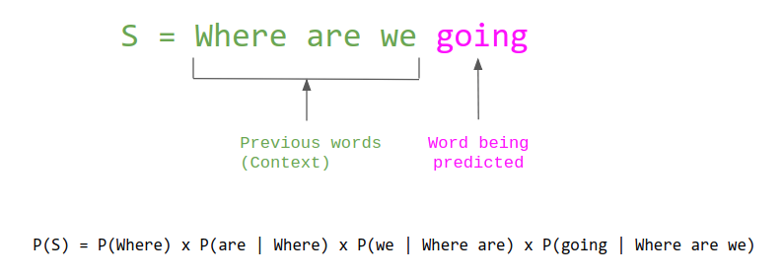
What is a language model? At least from a machine’s perspective???
A statistical language model is a probability distribution of tokens (words) across a sequence. I.e. P(next word|current word)
A Language Model is one which is able to predict a next word in a sequence/sentence of words.

Slide 6
Use of Language Models in numerous downstream tasks...
Sequence to Sequence models:
Information Retrieval
Question Answering
Machine Translation
Speech Recognition
Vector to Sequence models:
Image Captioning
Sequence to vector models:
Sentiment Analysis
Part of Speech Tagging
Named Entity Recognition
The above listed tasks are non-exhaustive.
The cumulation of trying to teach a machine to solve these tasks is known as Natural Language Processing.

Slide 7
How do we build a language model?
How might we build a network to understand the following sentence?
“The quick brown fox jumps over the wall”

Slide 8
How do we build a language model?
The dumbest way possible from what we’ve learnt so far...
Step 1: Word tokenization
“The”, “quick”, “brown”, “fox”, “jumps”, “over”, “the”, “wall”
Step 2: Feed into a fully connected neural network
The
FC Neural Network
quick
Next predicted word
brown
.
.
.

Slide 9

How do we build a language model?
Are we done? Is there a better way? Are all input sequences of the same length? Is language syntax transferable across different sentences? Do neighboring words share more correlation with one another?
2D convolutions: Will it work?
What if we tried 1D convolutions instead?
Imagine if we had a whole sequence of text...what would the consequences be if we did 2D convolution as was seen before in image processing methods? Would it still work?
The quick brown fox jumps over the wall.

Slide 10


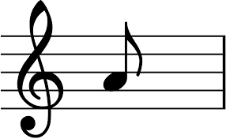

How do we build a language model?
But we’re still not done.
The inherent SEQUENTIAL structure of data is important information that we cannot ignore, and all neural network architectures that we’ve learnt thus far are rigid and fixed.
WHAT? WHY???
Examples data/information that makes sense sequentially are:

Slide 11
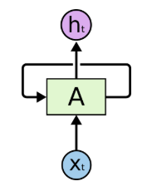
How do we build a language model?
quick
brown
fox
Hidden State 1
Hidden State 2
Hidden State 3
Memory
Memory
.
.
.
The
quick
brown
Recurrent Neural Network
Notes:
http://karpathy.github.io/2015/05/21/rnn-effectiveness/

Slide 12
How do RNNs actually work?
Many questions still exist as to how RNNs actually work.
The elephant in the room: How do we represent words into USEFUL values that our network can understand?
What operations does the neural network do on the inputs and hidden layers?

Slide 13
On the meaningful representation of words
One hot encode our words into vectors:
“The quick brown fox jumps over the wall.”
E.g. vocab_size of our sentence/number of unique words = 8
First word(“The”) = [1, 0, 0, 0, 0, 0, 0, 0]
Second word(“quick”) = [0, 1, 0, 0, 0, 0, 0, 0]
...So on and so forth
Are there any issues with this method? How useful is such a representation of words and is it efficient?

Slide 14
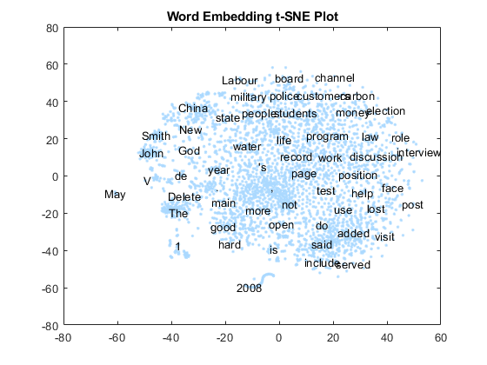
On the meaningful representation of words
Are we even certain about what the representation of words should be like? Why not try learning these representations?
WORD EMBEDDINGS

Slide 15
How do RNNs actually work?
Coming back to the original diagram that we had but with more detail
Output1
Output2
Output3
Hidden State 1
Hidden State 2
Hidden State 3
Embedding 1
Embedding 2
Embedding 3
.
.
.
The
quick
brown

Slide 16
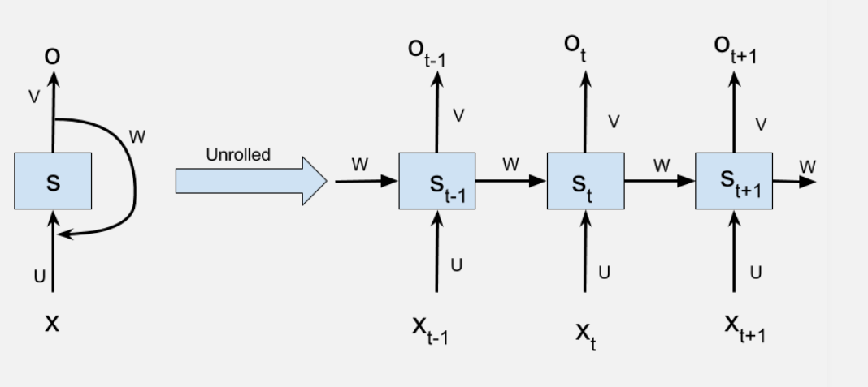
How do RNNs actually work?
t - time-step
X_{t} - (vector) input at timestep t
S_{t} - hidden cell state at timestep t → intended to reflect the memory of a particular cell
O_{t} - output at timestep t
W, v, u - learnable parameters that are shared across all time steps (I.E. the same, w, v and u are used at every time step)

Slide 17
How do RNNs actually work?
Governed by 2 main recurrent equations:
S_{t} = tanh(uX_{t} + wS_{t -1} + b₁)
O_{t} = vS_{t} + b₂

Slide 18
Practise Sentiment Analysis!

Slide 19
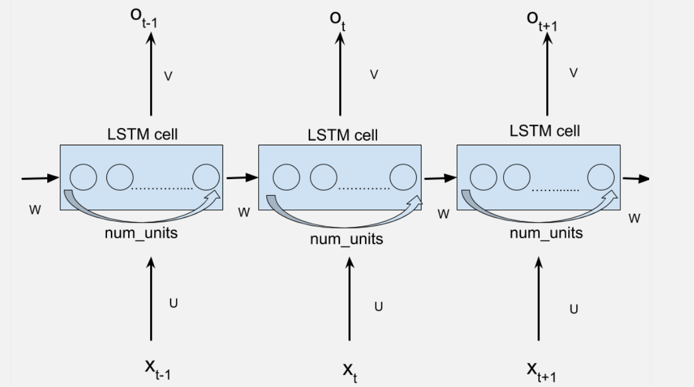
What num_units in Keras/Tensorflow means
Notes:
https://jasdeep06.github.io/posts/Understanding-LSTM-in-Tensorflow-MNIST/

Slide 20
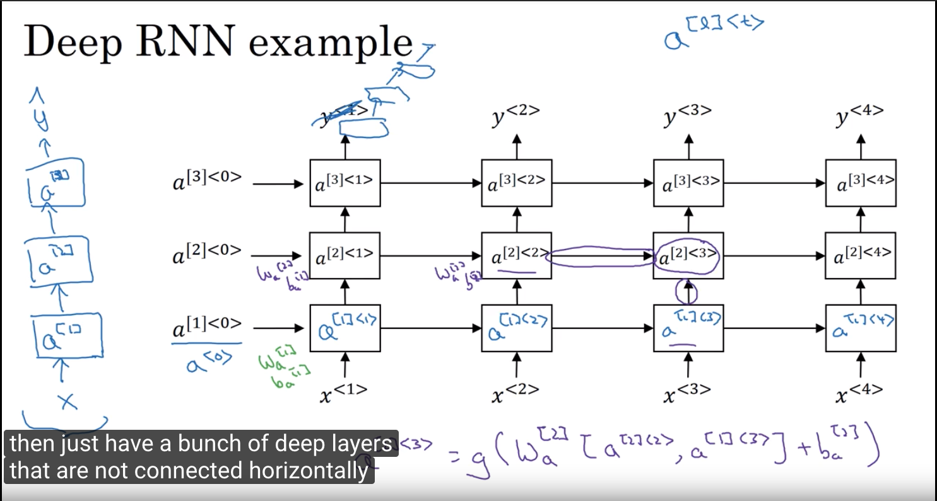
Stacked RNNs

Slide 21
Some concluding thoughts...
Can the representations of words be improved even further?
Transfer Learning in NLP applications?
Do RNNs sufficiently embody the way that humans understand language?

